Slide 1
Deep Learning 调研

Slide 2
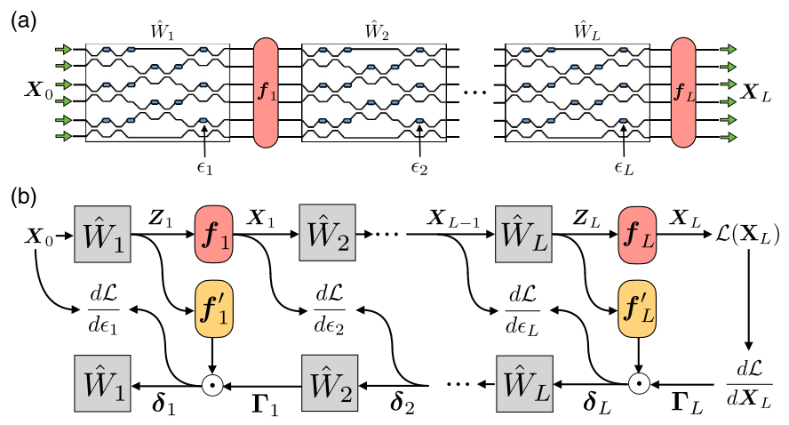
In situ backpropagation and gradient measurement
in situ intensity measurements.
requiring an integrated intensity detection scheme
physically implementing adjoint variable method
improved version of
Shen Yichen etal., Deep learning with coherent nanophotonic circuits, Nature Photonics, 2017
Schematic of the ANN architecture.
Illustration of operation and gradient computation in an ANN.
Shanhui Fan et al., “Training of photonic neural networks through in situ backpropagation and gradient measurement”, Frontiers in Optics/ Laser Science, 2018.

Slide 3
ANN细节
input vector ---> output vector via matrices
tuning matrix elements (weights) for minimized cost function
tuning is implemented by “backpropagation algorithm”
utilizing the chain rule from the output layer to the input layer

Slide 4
改进
对原文献的评价：the training of the phase-shifter settings for this system was performed using a model implemented on a standard computer, which does not take into account experimental errors, and furthermore loses all the potential advantages in time and energy of the photonic implementation.
改进：The only additional component that is required is a means to measure the light intensity in the vicinity of each of the tunable phase shifters.

Slide 5
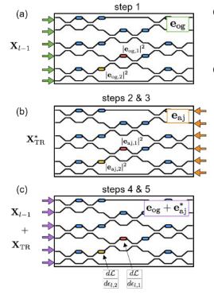
Send in the original field amplitude and measure and store the intensities at each phase shifter.
Send delta into the output ports and measure and store the intensities at each phase shifter.
Compute the time-reversed adjoint input field amplitudes.
Interfere the original and the time-reversed adjoint fields in the device, measuring again the resulting intensities at each shifter.
Subtract the constant intensity terms from steps 1 and 2 and multiply by k square to recover the gradient.
Shanhui Fan et al., “Training of photonic neural networks through in situ backpropagation and gradient measurement”, Frontiers in Optics/ Laser Science, 2018.

Slide 6
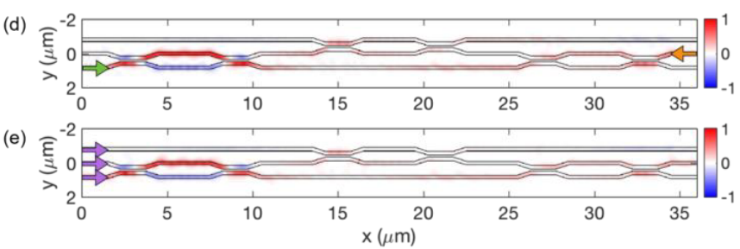
Restriction
Assuming linear, lossless, reciprocal, feed-forward propagation inside the OIU.
Mode-dependent loss limits the ability to accurately reconstruct the time-reversed adjoint field.
40% of the light is lost due to back-scattering and radiation losses for 3 * 3 operation. (shown below)
Shanhui Fan et al., “In-situ Backpropagation in Photonic Neural Networks”, Frontiers in Optics/ Laser Science, 2018.

Slide 7
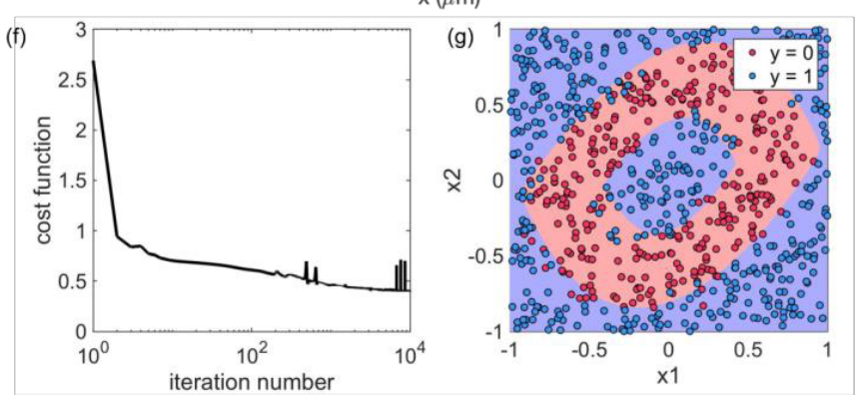
Results
91% precision
Shanhui Fan et al., “In-situ Backpropagation in Photonic Neural Networks”, Frontiers in Optics/ Laser Science, 2018.

